Slide 1


2026 Benefits Information:
Flexible Spending, and Additional Employee Benefits
Presented by
EASI GOV

Slide 2
What is Flexible Spending?
Plan | Minimum | Maximum
Health Care FSA 2026* | $130 | $1,700
Child Care FSA 2026* | $130 | $2,500
Flexible spending allow employees to set aside money for eligible expenses prior to taxes being withheld
  Health Care Flexible Spending Account (FSA)– covers eligible health care expenses.
  Child Care FSA– covers daycare expense for eligible dependents
  Short Plan Year 01/01/2026-06/30/2026
  Transportation and Parking Benefits – covers transit and parking expenses incurred traveling to/from work
Deductions are taken from your paycheck before taxes are withheld, reducing your withholding and saving you money
*Subject to Change by IRS announcement
Plan | Minimum-Monthly | Maximum-Monthly
Transit Benefit | $5 | $340
Parking Benefit | $5 | $340

Slide 3
Use It Or Lose It!
FSA Health and Child Care funds are ‘Use it or Lose it’ pre-tax deductions, and any unused funds are returned to your employer at the end of the plan year; They are not refunded.
Carefully consider your Health and Child Care elections so that you do not allocate funds that you will not use.
Short Plan Year, 01/01/2026-06/30/2026, Run-out 08/07/2026.
The State of New Mexico has a grace period (08/07/2026) to use your previous plan year expenses for the new year.
Transit and Parking benefit funds roll over every year and are not subject to Use It or Lose It.

Slide 4
Health Care FSA Expenses
Eligible Expenses
Ineligible Expenses
Services Covered by Insurance
Non-cosmetic dental expenses
Vision care expenses
Prescriptions
Some OTC (Over the Counter) medications eligible without LMN (Letter of Medical Necessity)
Expenses that aren’t medically necessary
Expenses that have not yet been incurred
Expenses incurred before plan enrollment
Eligible Dependents
Spouse
Children under 26
Ineligible Dependents
Domestic partners
Domestic Partners children
*Expenses will be reviewed for eligibility. Claims may require a receipt or Explanation of Benefits (EOB) that shows your name, medical provider, the date, the amount, and what service was received.

Slide 5
Child Care FSA Expenses
Eligible Expenses
Ineligible Expenses
Before/After School Care
Daycare
Senior Daycare
Summer Camp
Late pick-up fees
Registration fees*
Application fees*
Expenses paid to child’s parent or a child under the age of 19
Overnight Camps
Instructional or sport camps
Late payment fees
Educational Expenses
Eligible Dependents
Dependent Children 12 and younger
    *Not reimbursable until care has been provided
Ineligible Dependents
Domestic Partner Children

Slide 6

Transit and Parking Benefit
Enrollment and changes to elections can occur at any time during the year
Include costs of public or certain privately operated transit service
File and submit your claims through the mobile app or website
Only the employee is eligible for reimbursement
Mass Transit / Van-Pooling Reimbursement
  Vanpooling
  Vanpooling services, like Uber Pool
  Bus or Train Passes
Parking Reimbursement
  Parking by meter or lot at or near your workplace

Slide 7
Enrollment Rules
Health Care FSA
  Enroll during open enrollment, within 31 days of hire date, or Qualifying Event. Must re-enroll annually.
Child Care FSA
  Enroll during open enrollment, within 31 days of hire, or Qualifying Event. Must re-enroll annually.
Transportation and Parking Benefits
  Enroll or change election at any time
Open Enrollment for State of New Mexico employees is October 20st to November 20th.
The enrollment form for open enrollment will be available on Mybenefitsnm.com October 20st.
To enroll, go to https://www.mybenefitsnm.com/employeePortal.html and follow the enrollment instructions.

Slide 8
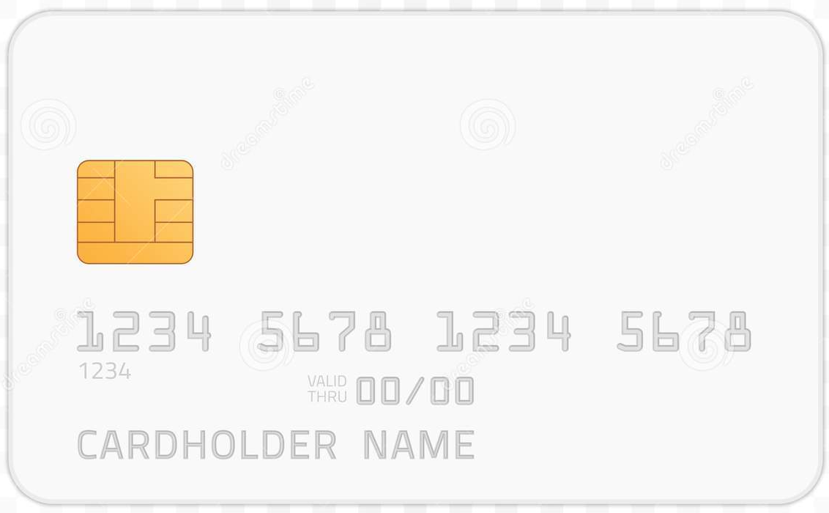

The FSA Debit Card
Provided for Health and Child Care
Two cards initially
Additional cards cost $10.00
Allows you to pay for qualified expenses directly from your FSA at time of service
  May still require additional documentation after purchase
  Keep detailed receipts and EOBs for all debit card purchase for claims submission

Slide 9
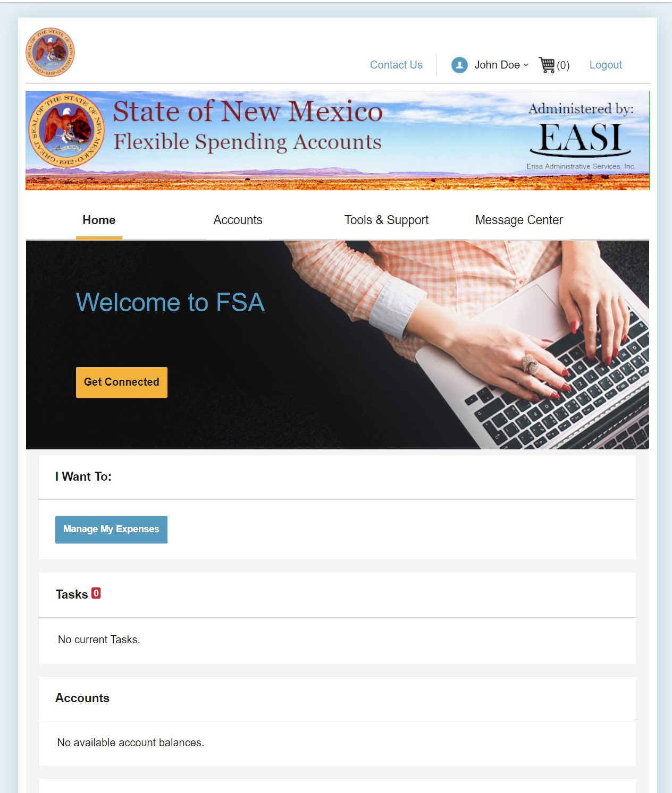
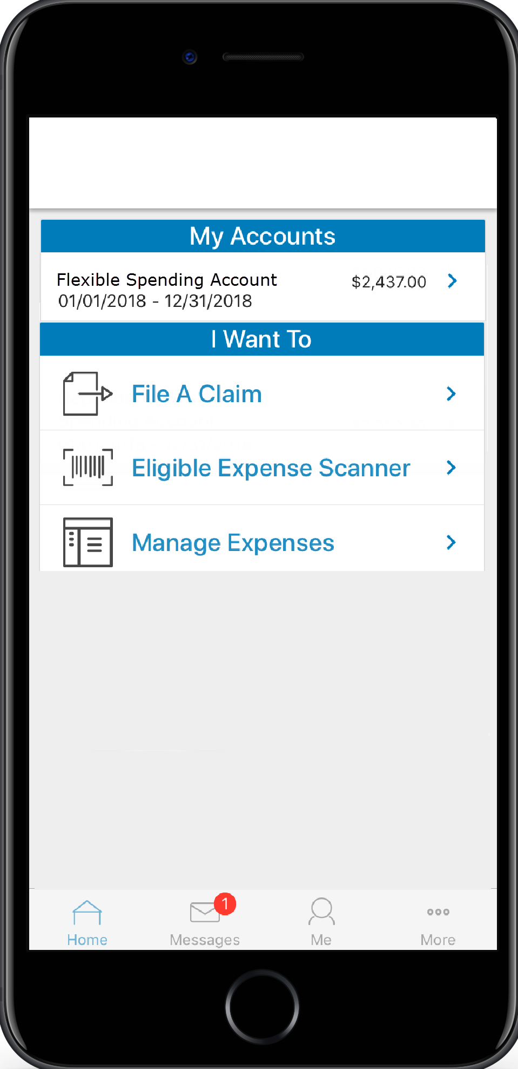
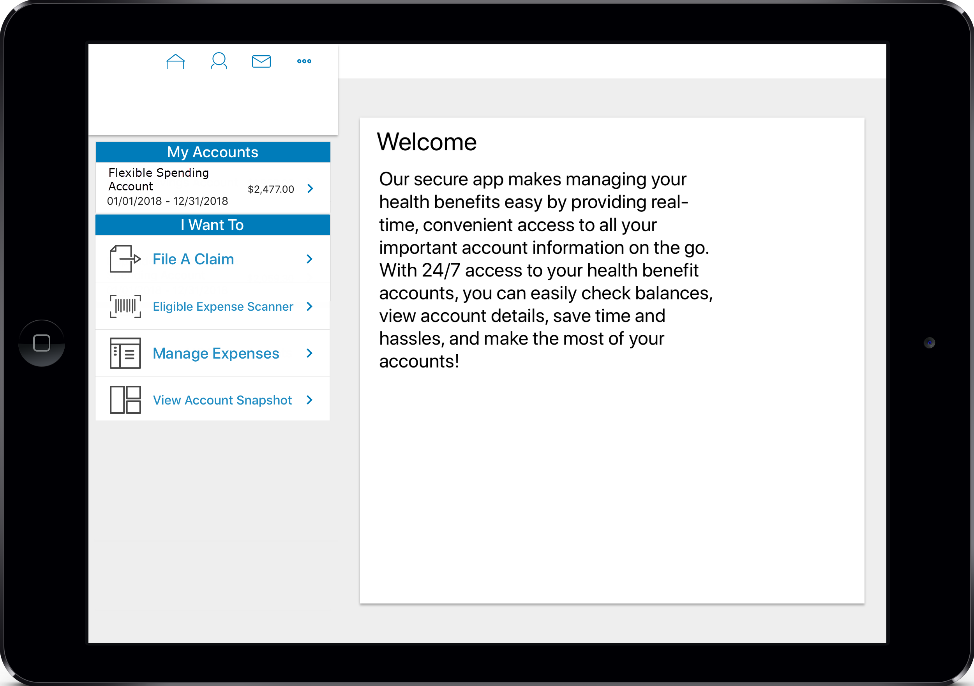
Where to Manage your FSA
Access your account online using your desktop or our mobile app
  You can visit Erisa Trust directly for the PC version of the app at https://www.erisa-trust.com/sonm and choose “Portal Login”
  To find the mobile app, search “BenefitsbyET” in the Google Play or Apple App store
Submit claims and upload receipts using the mobile app, or from your desktop
You can view your account and update your own contact information
Add your bank account to setup direct deposit of reimbursements and repayments
Visit https://www.mybenefitsnm.com/benefitsInformation.html# for more information

Slide 10
Documentation Requirements
Transit/Parking Requirements
FSA Health Requirements
Child Care Requirements
Detailed Receipt
Letter of Medical Necessity
Explanation of Benefits
Detailed Receipt
Proof of eligible expense
Tax ID information on the documentation
Period of the service provided
Proof of purchase
Documentation that clearly identifies the employee
Verifying the service or purchase is FSA eligible before paying, and asking for detailed receipts are the best methods for managing your claims

Slide 11
Paper Claim Submission
Access the paper forms at mybenefitsnm.com or through your portal
Receipts, EOBs and letters of medical necessity are still required
Email: FSA@easitpa.com
Fax: (505) 244-6009
Phone: (505) 618-1800
Mail:
  Flexible Spending Accounts
  Erisa Administrative Services, Inc.
  1200 San Pedro Dr. NE
  Albuquerque, NM 87110
  Remember: submitting a claim via the mobile app is the fastest route to reimbursement. Use the mobile app whenever possible.

Slide 12
Common FSA Questions
What documentation is required when submitting a claim?
The IRS requires the following: the name of person who received the service, the date of service, the cost, the providers information, and what services were rendered. This can usually be confirmed with the explanation of benefits and a detailed receipt.
What are the best practices when submitting a claim?
Ask for detailed receipts from the provider. Hold on to all paperwork pertinent to amounts paid.
Why has my FSA card been suspended?
The most common cause for suspension is missing supporting documentation. If supporting documentation has not been received within 30 days of an accrued expense, the relevant FSA account will be suspended. The account will stay suspended until documentation or repayment is rendered.
Why is it important to use and check the portal and /or phone app?
Communication about claims, updates for the plan year, and other notices are sent through the portal and mobile app.

Slide 13
Common FSA Questions Continued
Why do I have to submit documentation?
The FSA plan is a pretax benefit, with specific IRS regulations. The user of the benefit must provide documentation to substantiate that the purchase is FSA eligible.
What is the time frame I have to submit my documentation?
30 Days from the date the claim is processed. Two receipt request are sent after 10 and 20 days respectively. If a receipt has not been received by 30 days, an overdue notice will be sent out and the benefit will be suspended until documentation or repayment is provided.
Why can’t I cover my Domestic Partner, we have lived together X years?
NM is not a common law marriage state. Domestic partners are not recognized as legal dependents. Eligible FSA users are the employee, their spouse, and children age 26 and under.

Slide 14
Thank You!
For questions or assistance call 1-855-618-1800 or email FSA@easitpa.com

